Slide 1
Design

Slide 2
Introduction
Word count 300 approx.
You need to start your Design section with an introduction outlining the approach you will be taking. Some key points for you to cover:
Explain that you are going to be breaking the problem down into smaller tasks
Include some mention of the fact that this is decomposition
Justify why it is important to break the problem down into smaller tasks
Explain how you are going to break the problem down
E.g. Module by module. So designing modules for save, edit, print, etc. Individually
Prototyping:
You need to explain that you are breaking your solution down into prototypes (approx. 5)
You need to decide and explain now at which stage in development each prototype will be
E.g. Prototype 1 when all the forms have been created
Justify why you are choosing to break the problem down that way
Keep in mind that you will have roughly 7 weeks to develop your system so plan your approach accordingly.

Slide 3
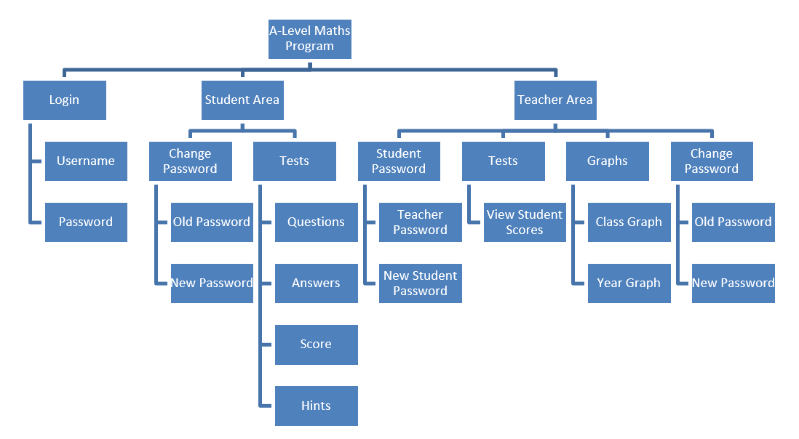
System Diagram
You need to produce an overall system diagram for the system that you are planning to create. This should show an overview of the elements of your system and how they link together. For a forms app your starting point will be like a sitemap for a website and then you can branch the functions out from there. E.g.

Slide 4
Program functions
50-100 words for the explanation of each function
200-300 words for the justification of how they all fit together
In this section you need to explain all of the functions identified in your systems diagram. For example, if you are producing a maths quiz one of your functions could be the one that sort’s user’s scores. If you are producing a game, it could be one that detects collisions. You need to identify and explain what each of these key functions does. Once you have explained each of these functions you will need to explain and justify how they all fit together to form a complete solution.

Slide 5
Pseudo-Code or Flowcharts
For each of the functions you have identified produce pseudo-code or a flowchart for each function. You need either pseudo-code or flowcharts for every part of the system that you have planned as part of your design. It is your choice whether to produce flowcharts or Pseudo-code for this section. I.e. Under the explanation of each subroutine, place the flowchart or pseudo-code for that subroutine. At the end you need to justify how they all fit together to form a complete solution.

Slide 6
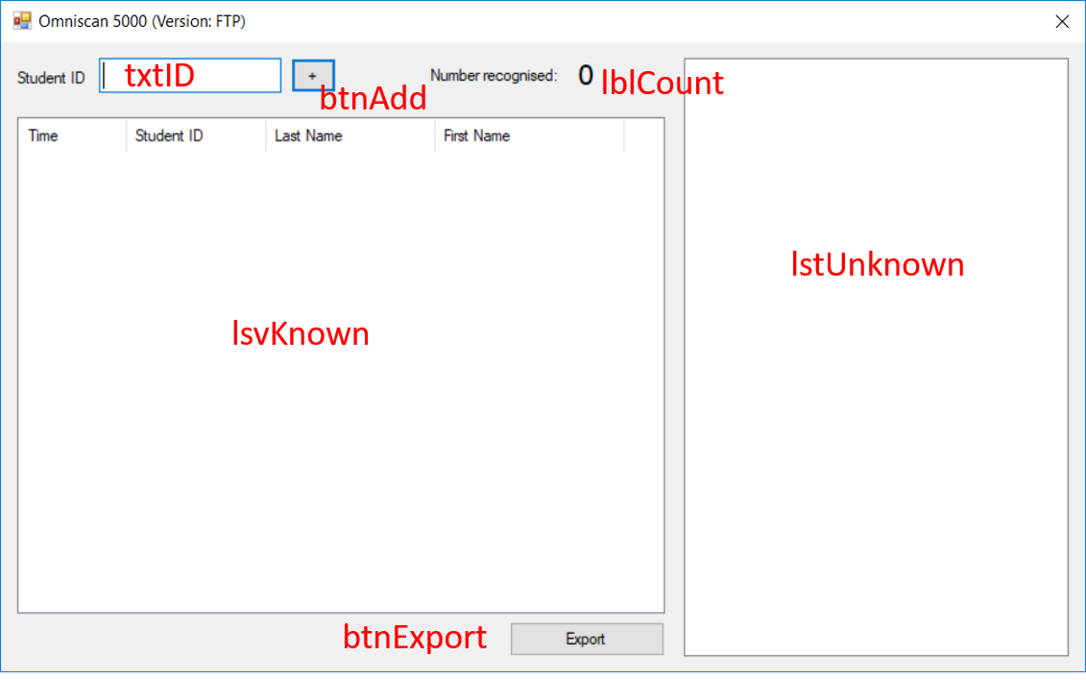
Form designs
You need to draw each of the forms that you are planning to use for your system. This can be done either electronically or on paper, if you use paper you need to make sure that you scan them in before you lose them. You will need to annotate your designs to show:
What colours you are using for your buttons, backgrounds etc.
What font/font size you are going to use for your writing
Explain the function of each item on the form. What is each button, dropdown etc. used for?
Important: This is also where you explain and justify any usability features you are including on that form. A usability feature is anything that you include which makes your system easier to use. E.g. A dropdown instead of a text box or adjustable/larger font sizes. This is very important because you need to show these clearly during development and discuss them during your evaluation. If you do not do this well, you will drop marks throughout the rest of your project.

Slide 7
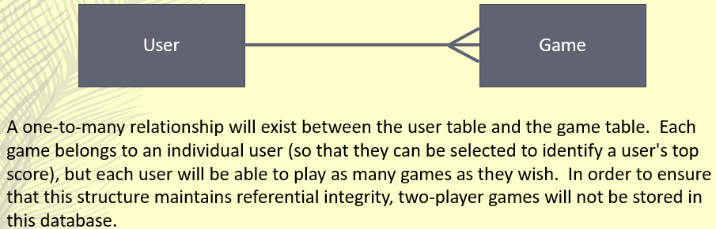
ER Diagram
You need to produce an ERD for your system
Explain your design
Note: Remember that an ER Diagram is used to describe the structure of a database. Each box represents an Entity (table) and the line between represent the relationships. Refer back to your notes on ERDs if you are struggling.

Slide 8
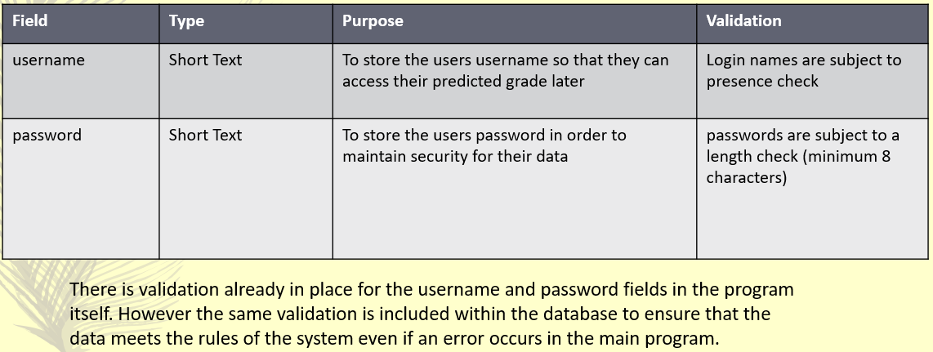
Data Dictionary
You need to produce a Data Dictionary for your system
Describe any validation in the table
Justify some key pieces of validation
Note: The data dictionary contains information on all the fields within your database. You should produce a separate table for each database table with a subheading above each to identify it

Slide 9
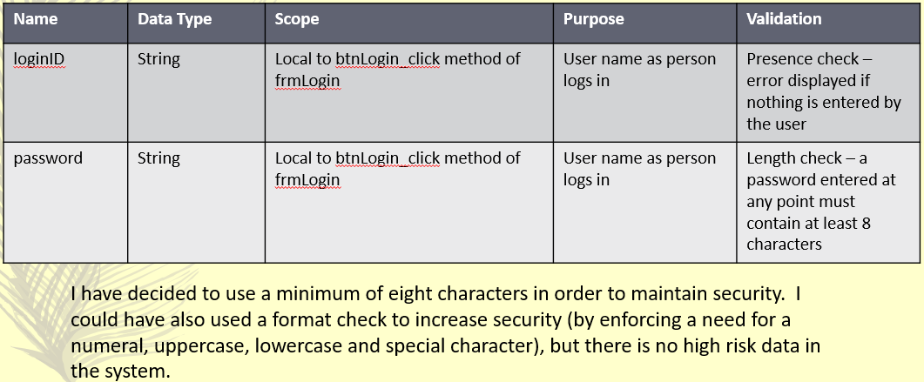
Variable table
You need to produce a table identifying the variables you will need
Describe any validation in the table
Justify some key pieces of validation
Note: Validation refers to rules that the data must meet in order to be valid. E.g. A date of birth cannot be a date after the current day

Slide 10
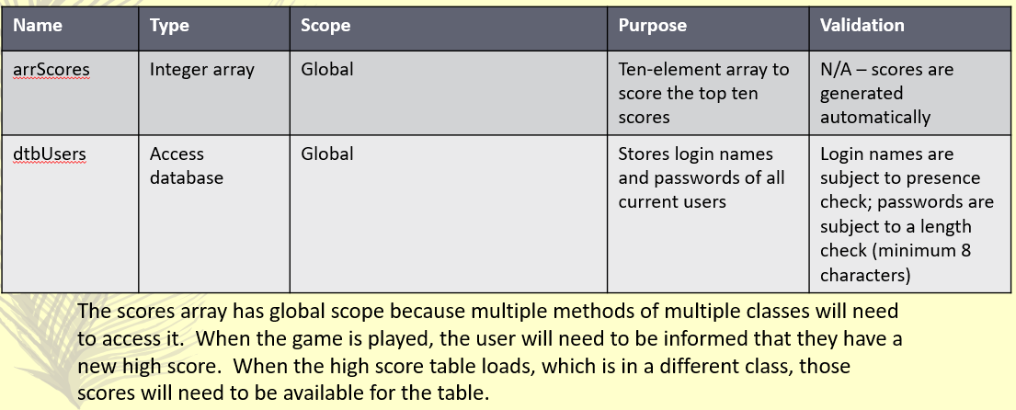
Data structures
You need to produce a table identifying any other data structures you will need
Describe any validation in the table
Justify some key pieces of validation

Slide 11
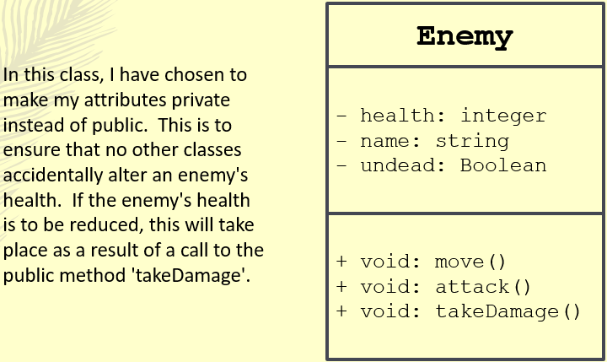
Class diagram
You need to produce a Class Diagram
Explain and Justify your design
Note: Remember these from when we did Object Oriented programming? A fun fact about VB is that every program is OO by default. Depending on your final program you may end up with a more bespoke class diagram with inheritance etc. In the case of this BTEC calculator, each of your forms is a class and odds are there will be no inheritance. So you need to produce a diagram like the one on the right for each of your forms with no lines between them. Name of the form at the top, attributes (variables) in the middle, methods (subroutines) at the bottom.

Slide 12
Test data for development
At this stage you need to identify and justify the test data to be used during your development process. This is not a full test plan, it is just the data that you will be using to test your program during the development process. You should use a combination of valid, invalid, valid extreme, invalid extreme and erroneous data.
Valid – Data that should be accepted by the system
Invalid – Data that should not be accepted by the system
Valid extreme – Data that should be accepted by the system but is on the edge of the acceptable range
Invalid extreme – Data that should not be accepted by the system but is on the edge of the acceptable range
Erroneous – Data that is provided in an incorrect format
For example if I asked for a whole number between 1 and 10
Valid – 5
Invalid – 79685
Valid extreme – 10
Invalid extreme – 11
Erroneous – Elephant
E.g. If I had a form where I had to enter a 4 digit pin, my test data may look like this:
Login form
Test data | Type
4896 | Valid
9999 | Valid extreme
10000 | Invalid extreme
1551618 | Invalid
Car | Erroneous
Ensure at this point that you justify your choice of test data. Why are you using the data that you are?

Slide 13
Test data for final testing
This is where we do produce a full test plan for our program. It should look to test that all of our success criteria have been met, that all of our usability features have been implemented and include any additional functionality you feel it will be important to test in order to discuss in your evaluation. Format:
Test number | What is being tested | Test data | Expected result
1 | That user cannot enter a date of birth in the future | 08/10/2020 | Program should produce an error message telling the user to select a date before today
Ensure at this point that you justify your choice of test data. Why are you using the data that you are?

